Slide 1
《计算与软件工程II 》
Ch15 “面向对象”的信息隐藏
丁二玉
南京大学软件学院

Slide 2
Information Hiding
Each module hides the implementation of an important design decision (secrets) so that only the constituents of that module know the details

Slide 3
Design Secrets need to hide…
Primary Secret: Responsibility Change
      Hidden information that was specified to the software designer
      From SRS
Secondary Secret: Implementation Change
  The implementation decisions made by the designer when implementing the module designed to hide the primary secret
  变化；

Slide 4
Main Contents
Encapsulation
  What should be hiding?
How to hiding change?

Slide 5
Encapsulation (1)
Encapsulation allows the programmer to group data and the subroutines that operate on them together in one place
Responsibility

Slide 6
Encapsulation (2)
hide irrelevant details from the user
a class can be divided into two parts, the user interface and the implementation.
The interface is the visible surface of the capsule.
  describes the essential characteristics of objects of the class which are visible to the exterior world
  The implementation is hidden in the capsule.
  The implementation hiding means that data can only be manipulated, that is updated, within the class, but it does not mean hiding interface data.

Slide 7
New View of Encapsulation
Old/Beginner/Implementation view of encapsulation:
hiding data inside an object
New view: hiding anything, including:
  Data (implementation)
  Structure (implementation)
  Other object (implementation)
  Type (derived classes)
  Change/vary (design details)
  …

Slide 8
Encapsulation Correctly ——ADT
ADT = Abstract Data Type
  A concept, not an implementation
  A set of (homogeneous) objects together with a set of operations on those objects
  No mention of how the operations are implemented
Encapsulation = data abstraction + type
  data abstraction: group data and operation
  Type: hiding implementation, make usage correctly

Slide 9
Why type?
A type may be viewed as a set of clothes (or a suit of armor) that protects an underlying untyped representation from arbitrary or unintended use.
It provides a protective covering that hides the underlying representation and constrains the way objects may interact with other objects.
In an untyped system untyped objects are naked in that the underlying representation is exposed for all to see.

Slide 10
Encapsulate Data
If needed, use Accessors and Mutators, Not Public Members
Accessors and Mutators is meaningful behavior
  Constraints, transformation, format…
public void setSpeed(double newSpeed) {
if (newSpeed < 0) {
sendErrorMessage(...);
newSpeed = Math.abs(newSpeed);
}
speed = newSpeed;
}

Slide 11
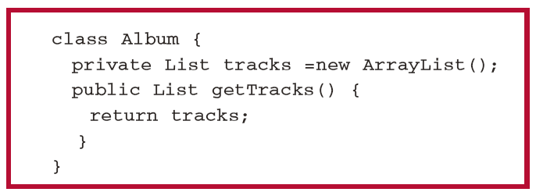
Encapsulate structures
See chapter 16 Iterator Pattern
References and Collection Data-Type !

Slide 12
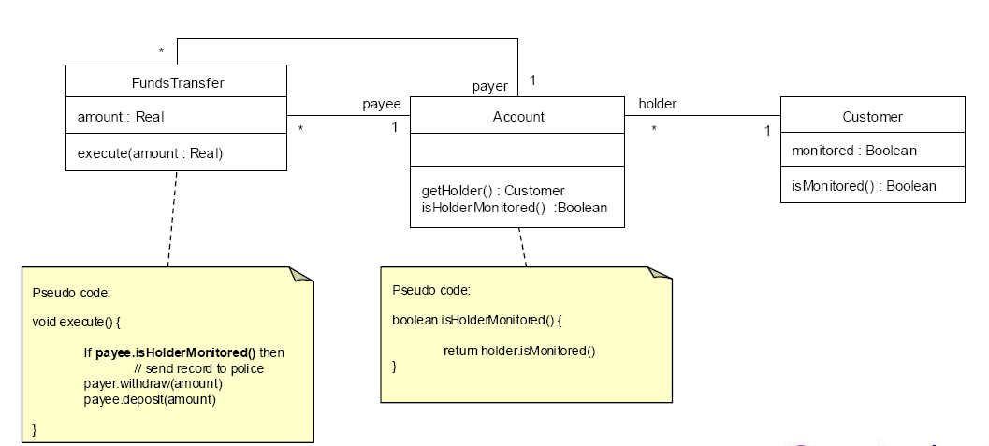
Encapsulate other objects
Collaboration Design
  Composition; delegation

Slide 13
Encapsulate type(subclass)
LSP
  pointers to superclasses or interfaces;
All derived classes must be substituteable
for their base class

Slide 14
Encapsulate Change (or vary)
Identify the aspects of your application that may change (or vary) and separate them from what stays the same.
Take the parts that change( vary ) and encapsulate them, so that later you can alter or extend the parts that vary without affecting the parts that don’t.
See DIP and OCP Later

Slide 15
Encapsulate Implementation Detail
Data
Structure
Other object
Type
Change/vary
…

Slide 16
Principle #1: Minimize The Accessibility of Classes and Members
Abstraction
  An abstraction focuses on the outside view of an object and separates an object’s behavior from its implementation
Encapsulation
  Classes should not expose their internal implementation details

Slide 17
Main Contents
Encapsulation
How to hiding change?

Slide 18
Example of Responsibility Change
void Copy(ReadKeyboard& r, WritePrinter& wp, WriteDisk& wd, OutputDevice dev){
int c;
while((c = r.read())!= EOF)
if(dev == printer)
wp.write(c);
else
wd.write (c);
}
Copy
Read
Keyboard
Write
Printer
Write
Disk
void Copy(ReadKeyboard& r, WritePrinter& w){
int c;
while ((c = r.read ()) != EOF)
w.write (c);
}

Slide 19
How to …
Abstraction is Key
  ...using polymorphic dependencies (calls)
Notes:
Design Principles - <number>
This effect is also the trick that makes C “function prototypes” useful. By depending on abstractions, we have greater freedom to change implementations. The C version works at link-time, but the OO version actually works at runtime also (polymorphism).
Notice that what happened above is a splitting of the server into an abstract, reliable part, and a concrete changeable part.
If a system is built on this principle, then a certain set of changes may be built by adding concrete implementations of classes without affecting the clients of their abstract interfaces.
This is also an important part of COM and CORBA.

Slide 20
Example of Responsibility Change
Copy
DiskWriter::Write(c)
{
WriteDisk(c);
}
Keyboard
Reader
Printer
Writer
Disk
Writer
void Copy(ReadKeyboard& r, WritePrinter& w){
int c;
while ((c = r.read ()) != EOF)
w.write (c);
}

Slide 21
Principle 10: Open/Closed Principle (OCP)
Software entities should be open for extension,
but closed for modification
B. Meyer, 1988 / quoted by R. Martin, 1996
Be open for extension
  module's behavior can be extended
Be closed for modification
  source code for the module must not be changes
统计数据表明，修正bug最为频繁，但是影响很小；新增需求数量一般，但造成了绝大多数影响
Modules should be written so they can be extended
without requiring them to be modified

Slide 22
OCP
RTTI is Ugly and Dangerous!
RTTI is ugly and dangerous
  RTTI = Run-Time Type Information
  If a module tries to dynamically cast a base class pointer to several derived classes, any time you extend the inheritance hierarchy, you need to change the module
  recognize them by type switch or if-else-if structures

Slide 23
// RTTI violating the
//open-closed principle and LSP
class Shape {}
class Square extends Shape {
void drawSquare() {
// draw } }
class Circle extends Shape {
void drawCircle() {
// draw } }
void drawShapes(List<Shape> shapes) {
for (Shape shape : shapes) {
if (shapes instanceof Square) {
((Square) shapes).drawSquare();
} else if (shape instanceof Circle) {
((Circle) shape).drawCircle(); } } }

Slide 24
// Abstraction and Polymorphism that does
// not violate the open-closed principle and LSP
interface Shape {
void draw(); }
class Square implements Shape {
void draw() {
// draw implementation } }
class Circle implements Shape {
void draw() {
// draw implementation } }
void drawShapes(List<Shape> shapes) {
for (Shape shape : shapes) {
shape.draw(); } }

Slide 25
OCP Summary
No significant program can be 100% closed
R.Martin, “The Open-Closed Principle,” 1996
Use abstraction to gain explicit closure
Plan your classes based on what is likely to change.
  minimizes future change locations
OCP needs DIP && LSP

Slide 26
Principle 11: Dependency Inversion Principle (DIP)
I. High-level modules should not depend on low-level modules.
Both should depend on abstractions.
II. Abstractions should not depend on details.
Details should depend on abstractions
R. Martin, 1996

Slide 27
DIP : separate interface from implementation ——abstract
Design to an interface,
not an implementation!
Use inheritance to avoid direct bindings to classes:
Interface
(abstract class)
Client
Implementation
(concrete class)

Slide 28
DIP Example
class Reader {
public:
virtual int read()=0;
};
class Writer {
public:
virtual void write(int)=0;
};
void Copy(Reader& r, Writer& w){
int c;
while((c = r.read()) != EOF)
w.write(c);
}
Copy
Reader
Writer
Keyboard
Reader
Printer
Writer
Disk
Writer

Slide 29
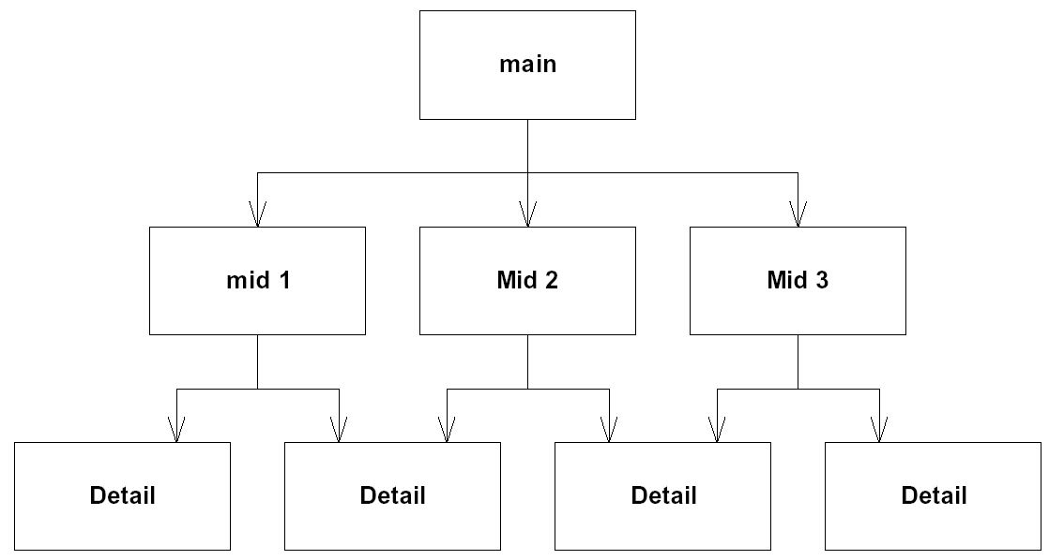
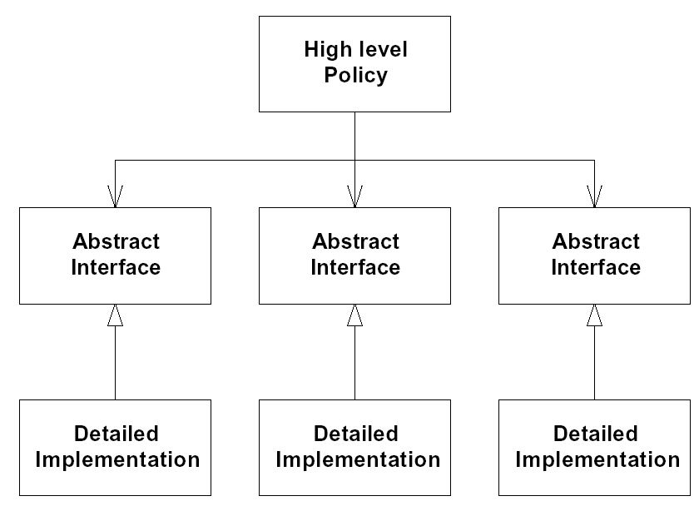
DIP Procedural vs. OO Architecture
Procedural
Architecture
Object-Oriented
Architecture

Slide 30
DIP summary
Abstract classes/interfaces:
  tend to change less frequently
  abstractions are ‘hinge points’ where it is easier to extend/modify
  shouldn’t have to modify classes/interfaces that represent the abstraction (OCP)
Exceptions
  Some classes are very unlikely to change;
    therefore little benefit to inserting abstraction layer
    Example: String class
  In cases like this can use concrete class directly
    as in Java or C++

Slide 31
How to deal with change
OCP states the goal; DIP states the mechanism;
LSP is the insurance for DIP

Slide 32
Example of Implementation Change
All ducks quack and swim. The superclass takes care of the implementation code
Duck
quack()
swim()
display()
//other duck-like methods…
The display() method is abstract, since all duck subtypes look different
display() method seems will be changed by new subtype
MallardDuck
display() {
// looks like a mallard}
RedHeadDuck
display() {
// looks like a redhead }

Slide 33
Single Responsibility Principle (SRP)
A class should have only one reason to change
Robert Martin
Duck
quack()
swim()
display()
//other duck-like methods…
SRS
and
display()

Slide 34
Information Hiding: Design changes!
the most common kind of secret is a design decision that you think might change.
You then separate each design secret by assigning it to its own class, subroutine, or other design unit.
Next you isolate (encapsulate) each secret so that if it does change, the change doesn’t affect the rest of the program.

Slide 35
See Chapter 16 Strategy Pattern
Duck
quack()
swim()
display()
//other duck-like methods…
DisplayBehavior
display()
MallardDuck
RubberDuck
RedHeadDuck

Slide 36
End

